Slide 1
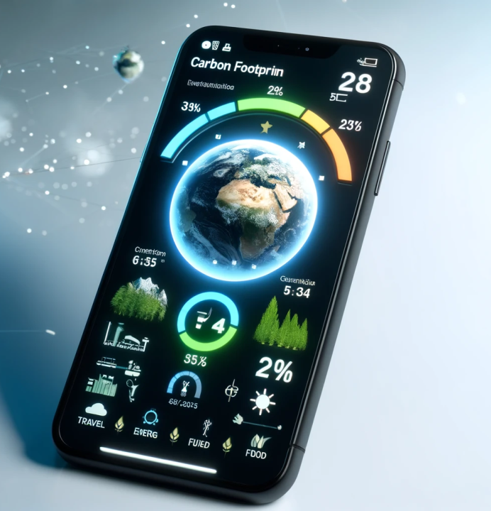
Title: EcoTracker –
Your Guide to a Greener Lifestyle
Submitted by:-
Ashutosh Verma
21SCSE1011016
Section:- 7

Slide 2
Overview
EcoTracker is a comprehensive mobile app developed to empower individuals and communities to take actionable steps towards reducing their carbon footprint. It aims to be a personal guide for a more sustainable lifestyle.
The app leverages advanced technology to gather data on users' daily activities, including transportation choices, energy consumption, diet, and shopping habits. This information is then analyzed to calculate the users' overall carbon footprint. Based on the collected data, EcoTracker provides personalized suggestions to help users make environmentally conscious decisions

Slide 3
Key Features of EcoTracker
1. Carbon Footprint Calculator: Allows users to input information about transportation, energy usage, diet, and consumption habits. Calculates their carbon footprint and provides a detailed breakdown.
2. Activity Tracking: Uses GPS and motion sensors to track modes of transportation (walking, cycling, driving, etc.). Provides feedback on the environmental impact of each choice.
3. Purchase Analyzer: Users can scan barcodes or manually input product information to see the environmental impact of their purchases (carbon emissions, water usage, waste generation.
4. Community Challenges: Users can participate in challenges and competitions with friends, family, or local communities to reduce their collective carbon footprint. Tracks progress and offers incentives for achieving sustainability goals.

Slide 4
Software Requirements
Programming Languages: Swift or Objective-C for iOS development, Kotlin or Java for Android development, and JavaScript for web development.
Development Frameworks: React Native or Flutter for cross-platform development, ensuring compatibility across different devices.
APIs: Integrate APIs for barcode scanning, geolocation, environmental data, and product databases.
Cloud Services: AWS or Google Cloud for data storage, analytics, and machine learning to improve recommendations.
UI/UX Design Tools: Sketch, Adobe XD, or Figma for designing an intuitive and visually appealing interface.

